Slide 1
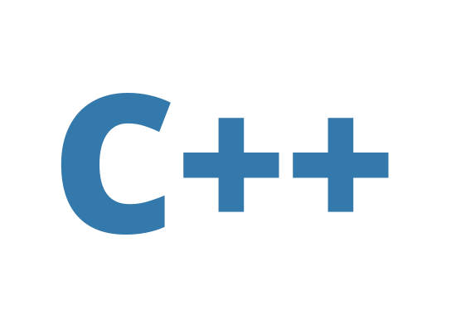



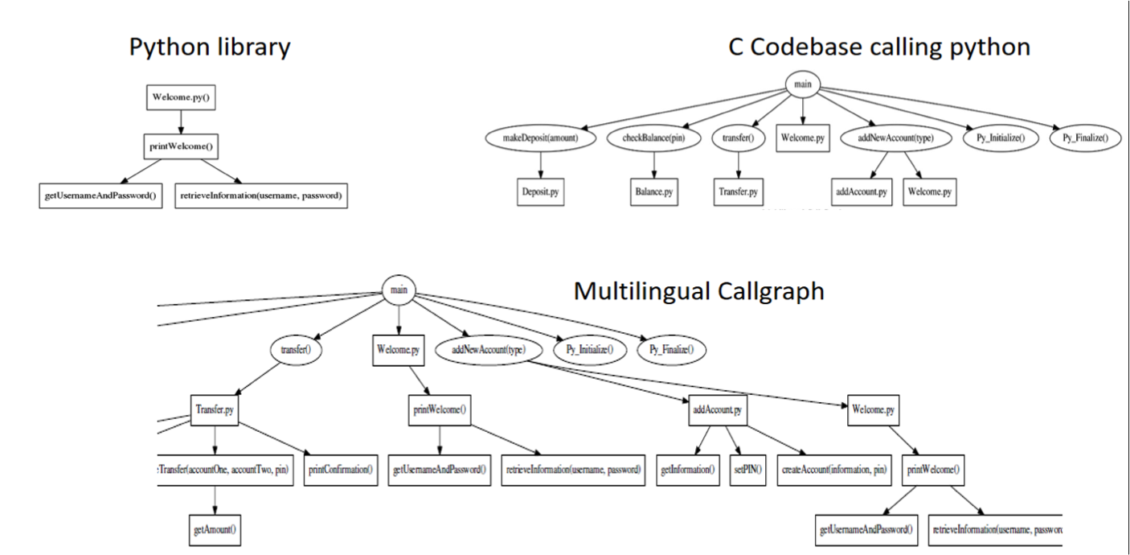
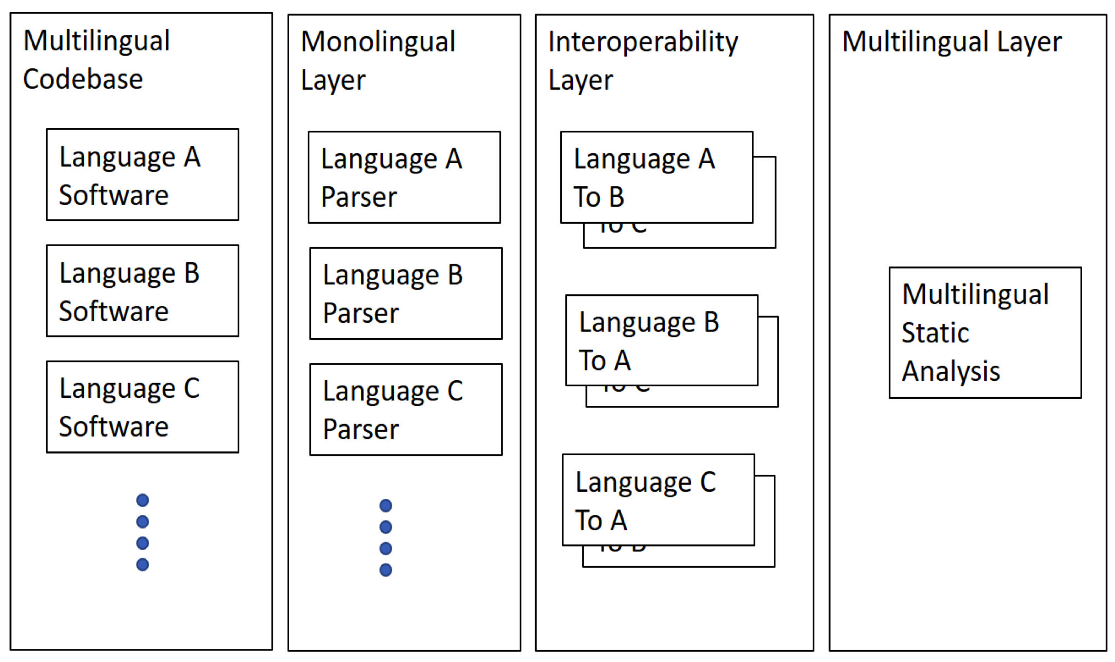
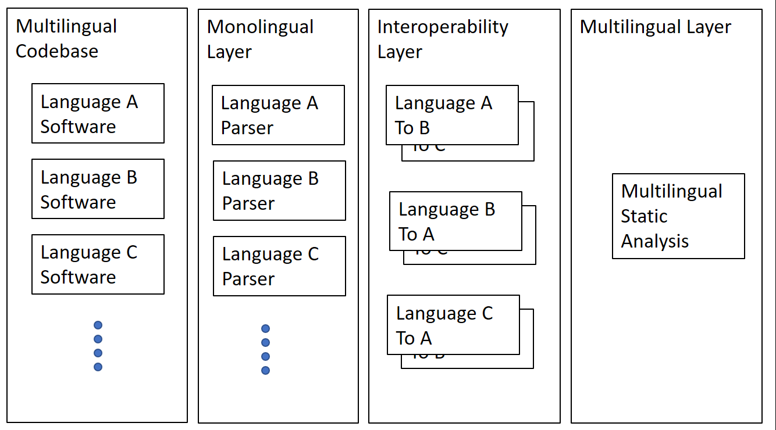
Multilingual Software Analysis
MLSA Research Group
Open Source Multilingual
Software Analysis Tool
Goal: To develop lightweight, open source tools that process multilingual codebases
    Use monolingual filters to produce language-
Independent files that can be analyzed and compiled into
unified common representations such as callgraphs
MLSA Software Architecture
How to Become Involved
Challenges of a
Multilingual Codebase
Redundancies in code (two
procedures of different languages
performing the same function)
Debugging Complexity (different
languages interact with each other
in potentially unexpected ways)
Security Issues (procedures of different
languages may be called incorrectly
or unsafely)
Download our repository and test our
open source code on your codebases
We would like to know if you found
this useful and/or there is functionality
you would like to see added.
Consider collaborating with us on
extending the software and adding new
functionalities
Contact:
Twiki: https://goo.gl/6mvyNS
Github: https://goo.gl/YsxHcR
Youtube:https://goo.gl/g8ra15
Email: multilingualsa@gmail.com

